Slide 1
Digital Portfolio
STUDENT NAME: P.SWATHI
REGISTER NO : 36324u18071
NMID:
DEPARTMENT:BSC(COMPUTER SCIENCE)
COLLEGE: COLLEGE/ UNIVERSITY:SREE ABIRAAMI ARTS AND SCIENCE COLLEGE FOR WOMEN THIRUVALLUR UNIVERSITY

Slide 2
PROJECT TITLE
FRONT END WEB DEVELOPMENT

Slide 3


AGENDA
Problem Statement
Project Overview
End Users
Tools and Technologies
Portfolio design and Layout
Features and Functionality
Results and Screenshots
Conclusion
Github Link
3/21/2024 Annual Review

Slide 4

PROBLEM STATEMENT
Many aspiring front-end developers struggle to showcase practical skills and creativity effectively. This portfolio aims to solve that by presenting real-world projects, responsive designs, and interactive UI components that demonstrate proficiency in HTML, CSS, JavaScript, and modern frameworks—bridging the gap between learning and application.

Slide 5

PROJECT OVERVIEW
This portfolio showcases a collection of front-end web projects built using HTML, CSS, JavaScript, and modern frameworks. Each project emphasizes responsive design, user-friendly interfaces, and real-world functionality, reflecting both technical proficiency and creative problem-solving in crafting engaging digital experiences.

Slide 6

WHO ARE THE END USERS?
The end users of this portfolio include potential employers, recruiters, clients, and collaborators seeking skilled front-end developers. It also serves students and peers exploring web development techniques, offering a clear demonstration of design thinking, coding proficiency, and user-centric project execution in real-world scenarios.

Slide 7

TOOLS AND TECHNIQUES
This portfolio utilizes tools like HTML, CSS, JavaScript, Git, and VS Code, alongside frameworks such as Bootstrap and React. Techniques include responsive design, API integration, DOM manipulation, and performance optimization—demonstrating a practical approach to building dynamic, user-friendly web interfaces across devices.

Slide 8
POTFOLIO DESIGN AND LAYOUT
A sleek, modern portfolio design showcasing creativity and professionalism. Use clean grids, bold typography, and high-resolution visuals to highlight your best work. Include an engaging introduction, project summaries, and contact details. Balance white space with vibrant accents to guide the viewer’s eye. Prioritize clarity, consistency, and visual impact to leave a lasting impression.
8

Slide 9
FEATURES AND FUNCTIONALITY
Highlighting intuitive features and seamless functionality, this portfolio showcases responsive design, interactive elements, and smooth navigation. Each section is optimized for performance and user engagement, with embedded media, dynamic transitions, and smart categorization. The layout adapts across devices, ensuring accessibility and clarity. Function meets form, delivering a polished experience that reflects innovation and technical finesse.

Slide 10
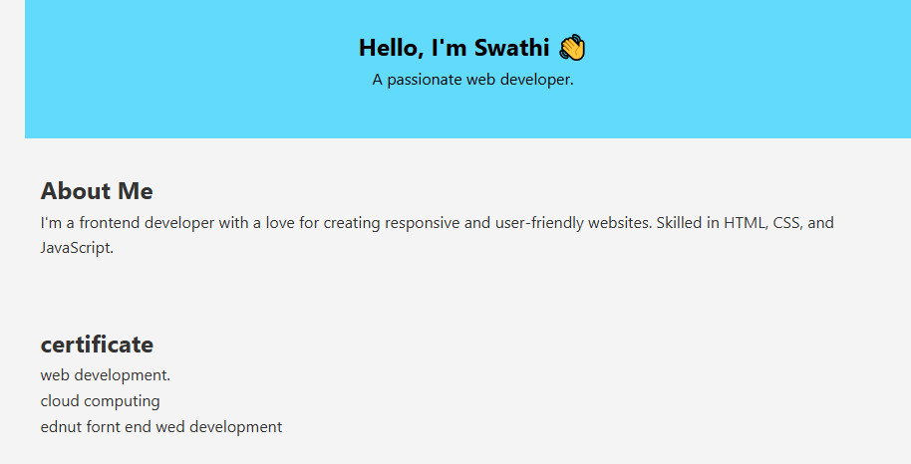

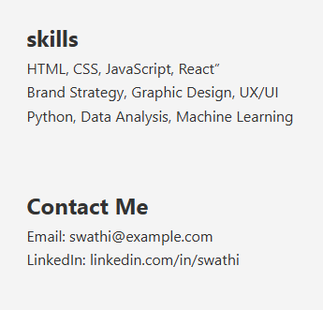
RESULTS AND SCREENSHOTS
3/21/2024 Annual Review
10

Slide 11
CONCLUSION
This portfolio captures a blend of creativity, skill, and growth. Each piece reflects dedication and thoughtful execution. It’s more than a showcase—it’s a stepping stone toward future possibilities, inviting collaboration and inspiring new ideas with every project shared.
11

